Slide 1
OPERATION ARCTIC CITADEL (OPAC)
Introduction Brief for VIS and JFACC volunteers
CAO: 2025-01-11
Version: 1.0
Notes:
Changes:
1.1: Minor updates to correct the brief IAW actual situation.

Slide 2
AGENDA
Situation / Road to war
Functions/Roles
Products
Generic timeline
Information flow/ Where to find information

Slide 3


Introduction to JFACC and VIS
Execution of the air campaign
CAO: 2025-01-11
Version: 1.0

Slide 4
VIS campaign planning
Notes:
Assess previous actions on earlier ATO days. Review JFC guidance and objectives, and JFACC objectives. Figure out what effects are needed to be accomplished on this ATO day to meet the objectives given in the JAOP + JFC Direction & Guidance.

Slide 5
Planning
Eny course of action assessment
  Most likely COA (ML COA)
  Most dangerous COA (MD COA)
Assessment of where enemy SAMs are located (CombatFlite file)
Any vulnerabilities for the enemy (lucrative targets to be struck)
  CARVER analysis (3.1.3.2.5.2 in VIS TTP)
Information Requirements (what do we not know)
IPB (as required from the VIS TTP, analyse and understand the enemy)
Air Campaign Planning Targeting meeting with JFACC (3.2.6 in VIS TTP)
INPUT:
Notia as candidate for Air Attack
Intrep’s
CJTF-23 Operations order

Slide 6

JFACC campaign planning
Notes:
Assess previous actions on earlier ATO days. Review JFC guidance and objectives, and JFACC objectives. Figure out what effects are needed to be accomplished on this ATO day to meet the objectives given in the JAOP + JFC Direction & Guidance.

Slide 7
Planning
Operational Environment Research (2.1.1 in JFACC TTP)
  Helpful with IPB from VIS
What are the objectives for JFACC (2.1.3 in JFACC TTP)
  Based on tasks given by CJTF-23 HQ in oporder ->
What are the strategy (plan) (2.1.4 JFACC TTP)
  Phasing (how to meet the objectives)
Locations for squadrons (what aircraft at which airbases)
Where to place Air Defense batteries (2.1.4.4 in JFACC TTP)
Where to place FAORs (2.1.4.4 in JFACC TTP)
Where to place tanker tracks
Where to place AWACS tracks
Revision of draft SPINS and adjust as required
Air Campaign Planning Targeting meeting with VIS
INPUT:
Notia as candidate for Air Attack
Intrep’s
CJTF-23 Operations order

Slide 8
VIS execution
Notes:
Assess previous actions on earlier ATO days. Review JFC guidance and objectives, and JFACC objectives. Figure out what effects are needed to be accomplished on this ATO day to meet the objectives given in the JAOP + JFC Direction & Guidance.

Slide 9

VIS: Intelligence cycle
Planning and direction
Dissemination
Collection
Production
Processing
Notes:
Planning and direction: determination of intelligence requirements, preparation of a collection plan, issuance of orders and requests to information collection agencies.
Collection: acquisition of information and the provision of this information to processing and/or production elements.
Processing: conversion of collected information into a form suitable to the production of intelligence.
Production: conversion of information into intelligence through the integration, analysis, evaluation, and interpretation of all source data and the preparation of intelligence products in support of known or anticipated user requirements.
Dissemination: conveyance of intelligence to users in a suitable form

Slide 10
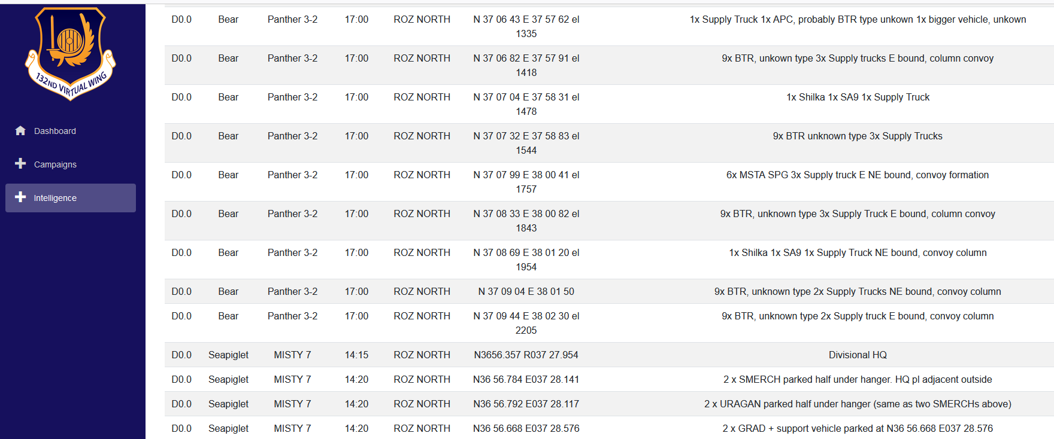
VIS Step 1: Processing
Register and process information in intelligence log (Campaign manager)
  Have functionality to export to CombatFlite
Notes:
All relevant information is registered in the VIS intelligence log and is organized for further production of intelligence. Pictures (screenshots), BDA report, observations, radar, RWR information, additional intelligence (VID) are all registered in the log for easier use during step 2 Production. All registered items are given a reference number to keep track and avoid double reporting. In addition to the intelligence log, all entries are also exported to a CombatFlite file. This make it easier for VIS members to see connections and how the various entries are related to each other and to enemy activity in step 2.

Slide 11
VIS Step 2: Analysis and production
VIS:
Use all available information and intelligence and use best judgement to understand the situation.
INTSUM: (Same information that is used in tgt meeting)
BDA from last ATO day
Current enemy ground disposition (facts+assessment)
Current enemy air disposition (facts+assessment)
Current enemy air defense disposition (facts+assessment)
Assessed enemy most likely course of action (ML COA) and most likely dangerous course of action (MD COA) for next 24-48 hours (next event), and more long-term (next phases)
Recommendations
Intelligence gaps/Intelligence requirements
Notes:
VIS members use all available information from last ATO day, previous events, intelligence reports and background intelligence reports and create a summary of intelligence after that ATO day. The intelligence summary may consist of:
BDA from last ATO day
Current enemy ground disposition (facts+assessment)
Current enemy air disposition (facts+assessment)
Current enemy air defense disposition (facts+assessment)
Assessed enemy most likely course of action (ML COA) and most likely dangerous course of action (MD COA) for next 24-48 hours (next event), and more long-term (next phases)
Recommendations
Intelligence gaps/Intelligence requirements
In addition to the intelligence summary, VIS may produce additional intelligence reports (INTREP) on specific subjects. For example, going more into detail about capabilities, assessments on topics such as air defense, enemy air forces, enemy high value units, specific area, enemy course of actions etc.
NOTE: Focus is on understanding the enemy and the situation doing the analysis of available information and intelligence. The products are just a way of conveying the information. Do not feel restricted by any template or specific product. Convey the intelligence in any way suitable.

Slide 12
VIS Step 3: Dissemination
Make information available for everyone
INTSUM is what is produced for the TGT Meeting
CombatFlite file with IADS information for pilots planning
Notes:
Once VIS have created an intelligence summary of the last ATO day, the report is published and made available for both JFACC and all participants in the campaign in a suitable form. The intelligence and understanding of the situation and the enemy that VIS have can be either a written report or can be presented verbally at briefings. The product itself is not what is important. The product is just a way to convey the information in the most efficient way.

Slide 13
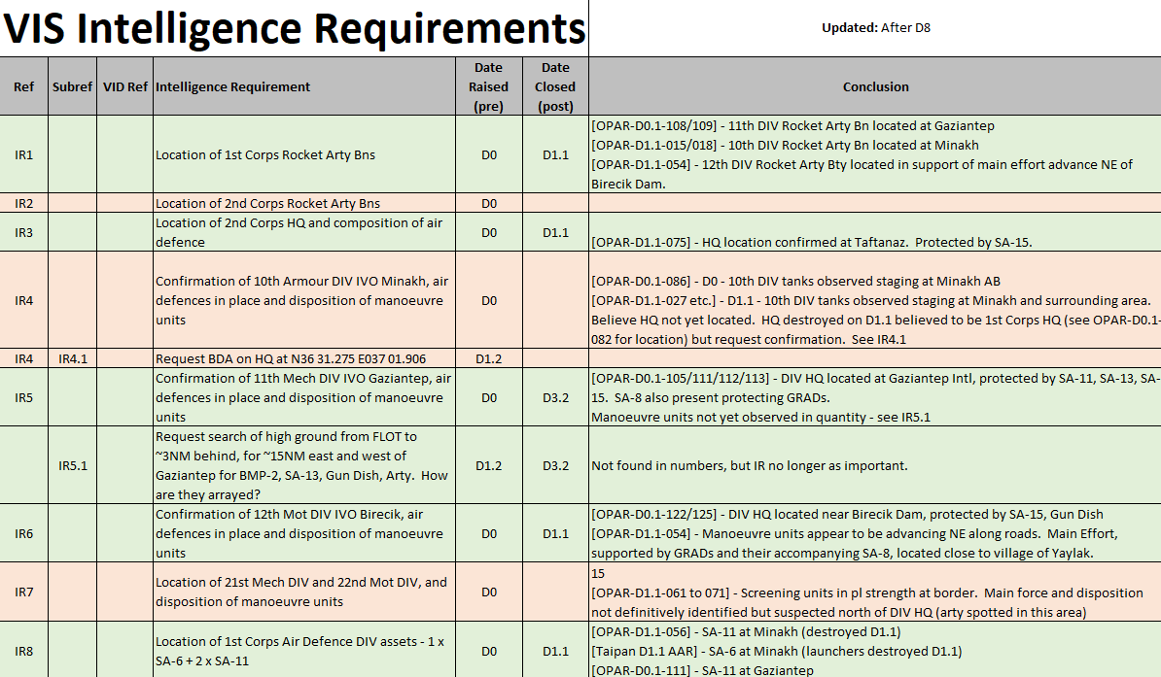
VIS Step 4: Planning and direction
Intelligence gaps (Based on overall guidance and current situation)
  For tasking (intelligence collection by pilots/controllers)
  RFI (to VID)
Targeting meeting
  See slide later
Notes:
As a preparation for the next event, VIS members look at overall guidance in JAOP and AOD and look at their current intelligence gaps and based on this identify intelligence requirements that are presented to JFACC. JFACC will include these intelligence requirements into their air tasking cycle (stage 2) and if prioritized flights will be tasked to collect information to answer the intelligence requirements. The intelligence gaps can also be forwarded to VID (mission designer) as a request for information (RFI).
With all intelligence produced and disseminated during step 3 and 4 VIS have the necessary intelligence and SA to support JFACC for the next event. During this step VIS and JFACC therefore may conduct a “targeting meeting”.

Slide 14
VIS Step 5: Collection
VIS no role
Notes:
As a preparation for the next event, VIS members look at overall guidance in JAOP and AOD and look at their current intelligence gaps and based on this identify intelligence requirements that are presented to JFACC. JFACC will include these intelligence requirements into their air tasking cycle (stage 2) and if prioritized flights will be tasked to collect information to answer the intelligence requirements. The intelligence gaps can also be forwarded to VID (mission designer) as a request for information (RFI).
With all intelligence produced and disseminated during step 3 and 4 VIS have the necessary intelligence and SA to support JFACC for the next event. During this step VIS and JFACC therefore may conduct a “targeting meeting”.

Slide 15
VIS Cycle (Per ATO Day)
Targeting Cycle
Step 1
Step 2
Step 3
Process raw intel
Update OOB
Update IR list
Update VIS Timeline
Analyse intel
Prepare new .cf summaries
Determine COAs
Update IR list
Present intel
Produce any further deliverables that may be needed (e.g. .cf layers, extra info on particular targets)
Pilots fly mission and report intel
Should all be reported in Campaign Manager
Sometimes need to look at AARs as well
VID summary and JFC Guidance can also provide further info
Targeting Meeting
See TTP for rough agenda
VIS present first
JFACC present next
Discuss target priorities
Targeting meeting planning
Decide target recommendations
Prepare presentation
Step 5
Step 4
Step 4

Slide 16
JFACC execution
Notes:
Assess previous actions on earlier ATO days. Review JFC guidance and objectives, and JFACC objectives. Figure out what effects are needed to be accomplished on this ATO day to meet the objectives given in the JAOP + JFC Direction & Guidance.

Slide 17
JFACC Stage 1: Objectives and effects
Review updated guidance from JFC (Directions & Guidance)
Assessment of previous actions (earlier ATO days) that have an impact on coming ATO day
Notes:
Assess previous actions on earlier ATO days. Review JFC guidance and objectives, and JFACC objectives. Figure out what effects are needed to be accomplished on this ATO day to meet the objectives given in the JAOP + JFC Direction & Guidance.

Slide 18
Targeting meeting
VIS:
Weather (forecast for next period)
Current enemy situation (Ground, Air, IADS)
BDA last ATO
Enemy ML/MD COA next ATOs (24-72 hours out) (Any changes to already briefed ML/MD COA)
Current TST list
Intelligence Requirements (intelligence gaps)
Any recommendations for targeting
JFACC:
Current friendly situation (Ground and air, including supporting assets and ordnance status) and planned operations next period.
New guidance from JFC (Directions and Guidance or orders received with guidance)
Air requests from Land Component Commander (LCC or Maritime Component Commander (MCC).
What assets are available for next ATO day (to be tasked with targeting)
Notes:
Representatives from VIS and JFACC may meet to synchronize their effort prior to the next ATO day. This can be conducted as a meeting but may also be conducted by providing the necessary information if time for a meeting is not possible. The targeting meeting can be conducted for each ATO day, or for any interval JFACC and VIS deem necessary (For example every other ATO day, or once for every phase). Ideally the targeting meeting start JFACCs stage 2 (Targeting, weaponeering, MAAP and AOD) in the Air Tasking Cycle.
VIS will start the targeting meeting with presenting:
Weather (forecast for next period)
Current enemy situation (Ground, Air, IADS)
BDA last ATO
Enemy ML/MD COA next ATOs (24-72 hours out) (Any changes to already briefed ML/MD COA)
Current TST list
Intelligence Requirements (intelligence gaps)
Any recommendations for targeting
JFACC will then present the following information:
Current friendly situation (Ground and air, including supporting assets and ordnance status) and planned operations next period.
New guidance from JFC (Directions and Guidance or orders received with guidance)
Air requests from Land Component Commander (LCC or Maritime Component Commander (MCC).
What assets are available for next ATO day (to be tasked with targeting)
The information presented by both VIS and JFACC give everyone a good understanding of the enemy and friendly situation. The next item to be presented are JFACC and VIS nominations to the Joint Prioritized Target List for the next ATO. After the nominations VIS and JFACC will discuss and agree on a prioritized list of the targets. If there are any discrepancies, JFACC will have the final word. This will be the approved JPTL for next ATO cycle.
JFACC and VIS will also present and suggest a draft JPTL for the subsequent ATO cycles so both VIS and JFACC know what the likely priorities on the subsequent ATO cycles are, as this also may drive intelligence collection efforts.
Finally, VIS and JFACC validate the time sensitive target list (make sure to add new TSTs if required or remove TSTs if applicable).

Slide 19
TGT Meeting
Weather (Mission designer)
Significant events (JFACC/VIS)
Enemy situation (VIS)
  Ground
  Air
  IADS
  Maritime
  BDA
Enemy ML COA (VIS)
Enemy MD COA (VIS)
Targeting recommendations (VIS)
New intelligence requirements (VIS/JFACC)
Friendly situation (JFACC)
Available ordnance (JFACC)
Assets available (JFACC)
Direction and Guidance (JFACC)
Apportionment (JFACC/mission designer)
JFACC Current plan/strategy (short/long term) (JFACC)
Target nominations (All) (JFACC/VIS)
Master Air Attack Plan (MAAP) draft (JFACC)
Example from OPAR:
OPAR TGT MEETING D12

Slide 20
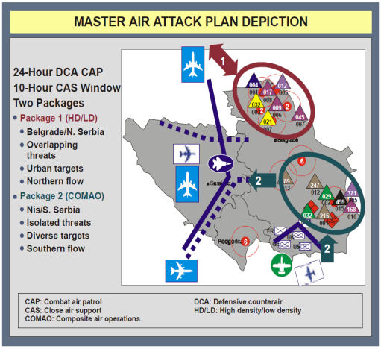
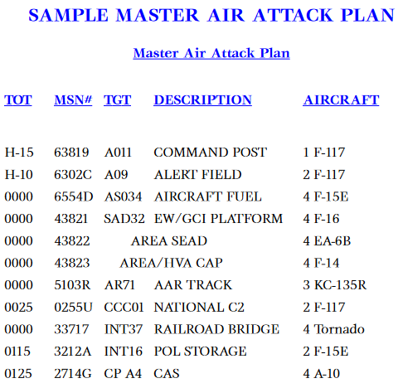
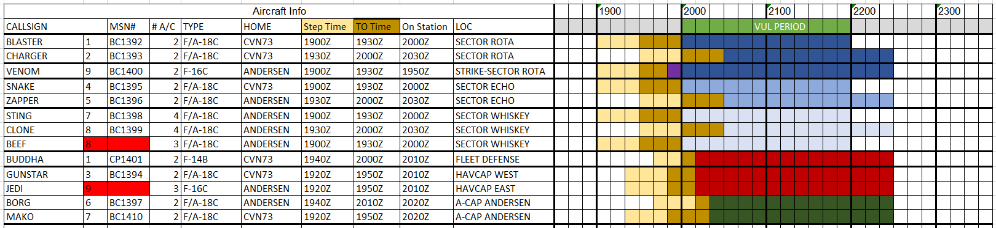
JFACC Stage 2: Targeting,weaponeering,AOD
Targeting meeting with VIS
Input to the substeps
Step 1:
Air Request Review
Information requirements (From VIS)
Step 2:
Targeting and weaponeering
Step 3:
Master Air Attack Plan
Notes:
The targeting meeting will kick of this stage for JFACC

Slide 21
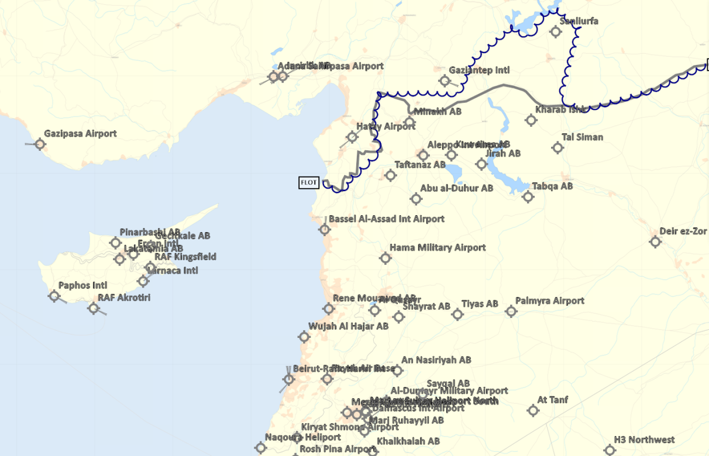
Example MASTER AIR ATTACK PLAN (MAAP), OPAR
Event 1 (D12.1)
Event 2 (D12.2)
CAS/AR/SCAR
CAS
AR
CAS/AR/SCAR
CAS
AR
CAP (+NTISR)
CAP (+NTISR)
DEAD RUS SA-10
DEAD
Escort
Strike Tiyas Airbase
Escort
Strike
SEAD
Shape for strike Tiyas Airbase
DEAD/NTISR (self-escort)
Shape for strike Shayrat Airbase
Escort
DEAD/NTISR
CAP
MCC responsible
CAP
MCC responsible
SCAR / AR
MCC responsible
SCAR / AR
MCC responsible
Anti-ship strike/SEAD/DEAD
MCC responsible
Anti-ship strike/SEAD/DEAD
MCC responsible
Next ATO Day (D13)
Strike Shayrat Airbase
TBD
Strike Hama Airbase
TBD
Notes:
Explanation:
What targets are so important that they warrant a retasking from all other targets/missions.
This slide is not intended to be pre-filled and is intended as a discussion between JFACC, VIS, LCC, MCC

Slide 22
JFACC Stage 3: AOD/ATO/ACO
JFACC translates MAAP into:
Air Operations Directive
  Per ATO Day
  Priority between:
    Requests from LCC / VIS Information Requriements
    Targeting (”Winning the war”)
    Area Air Defense Commander (AADC)
  Airspace Control Authority
Air Tasking Order
  Per event (one person recommended), translates the AOD and MAAP into executable taskings (flights, packages, frequencies, timings, weapons, targets, coordination)
Airspace Control Order
  CombatFlite file with relevant airspace for event
Notes:
Assess previous actions on earlier ATO days. Review JFC guidance and objectives, and JFACC objectives. Figure out what effects are needed to be accomplished on this ATO day to meet the objectives given in the JAOP + JFC Direction & Guidance.

